Slide 1

Assessment Self-presentation
Python Level 3
Artem Kharchyshyn
02.2024.
CONFIDENTIAL | © 2024 EPAM Systems, Inc.

Slide 2
Introduction - Who I am
Current title - Software Engineer
Current roles – Technician Team Lead
Key skills – Core Python, Agile, leadership and mentoring, pytest, software architecture knowledge.

Slide 3
Working experience/career path
2011
ILogos Game Studios (Full Stack Developer)
Title: Software engineer
2015
Nika Entertainment – Buttons Mix (Team lead)
Title: Software engineer
2017
ILogos Game Studios–Gardenscapes
(Developer)
Title: Software engineer
2019
EPAM – REFI-EAPI
(Technician Team Lead)
Title: Software engineer

Slide 4
Contribution to projects and your achievements
During my time working on the REFI-EAPI project, I faced several challenges:
1. Designing the Testing Framework: One of the initial challenges was designing a robust testing framework to effectively test our application. This required an in-depth understanding of the application and features to be tested, as well as knowledge of Python's Behave and pytest tools. I faced this challenge head-on by thoroughly studying the application and using my acquired knowledge on these tools to build the framework that successfully achieved our testing objectives.
2. Coordination within the team: As the team expanded, coordinating tasks among the members became more complex. To overcome this, I introduced collaborative tools and methods to improve the flow of communication, ensuring everyone was aware of their roles and responsibilities and paving the way for efficient teamwork.
3. Meeting project deadlines: There were times when we faced tight deadlines. This was especially challenging when unexpected issues arose. However, these moments taught me the importance of effective time-management, prioritization, and problem-solving. I managed this by addressing the most critical tasks first, delegating appropriately, and pulling in extra hours when necessary.
Facing these challenges not only helped build my technical skills but also honed my problem-solving, communication, and leadership abilities. Each challenge presented an opportunity to learn, grow, and prepare for larger responsibilities.

Slide 5
Contribution to EPAM and non-project activities
Outside of the REFI-EAPI project, I have been part of various initiatives that aim to contribute to the overall development of the EPAM.
I was involved in mentoring program Switch To Python.
I was involved in interviewing students from the EPAM Lab. My role was to assess their knowledge and skills. This experience not only allowed me to contribute to the development of potential talent for EPAM but also honed my skills in technical assessment and mentoring.

Slide 6
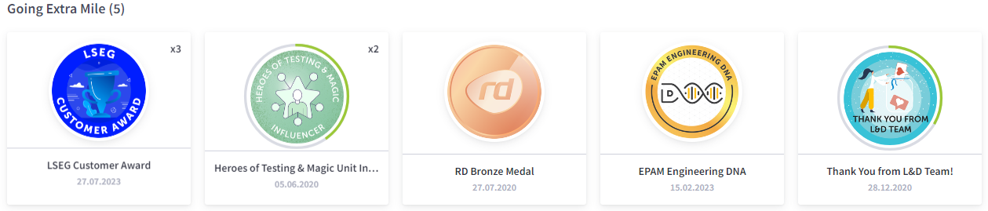
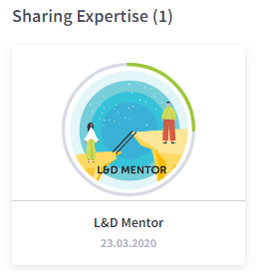
EPAM Badges

Slide 7
Summary - justification for promotion and goals for future
I believe I am ready for a promotion because: - 1. Expanding Role: I have been taking on duties beyond my current position. This includes leading the project, helping train new team members, and working directly with Product Owner. - 2. Completed Project: Our REFI-EAPI project was a success and our client, Refinitiv, was happy. - 3. Leadership: I have shown my ability to lead by taking charge of the team during the absence of the team lead, managing tasks and ensuring deadlines were met. - 4. Skill Growth: I have become much better at using core python, asyncio, behave and pytest. - 5. Process Improvement: I have improved our team's efficiency by introducing new processes for better product quality and code architecture. All these experiences have helped me learn and grow. I am ready to take on bigger challenges and responsibilities.
I want a promotion because I strive to grow and face new challenges. I believe I am ready to tackle bigger tasks, manage project, and make a stronger impact. In the future, I aim to use the extended role to improve our projects and teamwork. In the future, I plan to keep expanding my skills and knowledge. My goal is to take on leadership roles where I can solve complex problems, help our team work better together, and ensure our clients are happy. I also want to share what I have learned with new team members, to help them grow as well.

Slide 8
Thank you!

